Slide 1
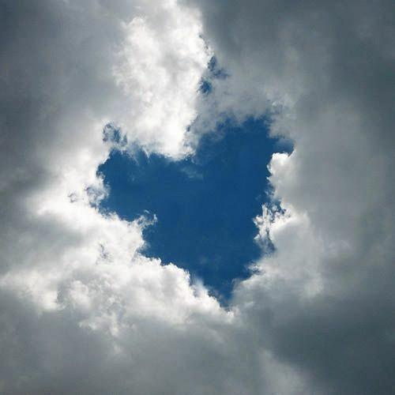
BEYOND OUR UNDERSTANDING

Slide 2
God, our God, is an amazing God Incredible, more than we can ever imagine. Everything He needs to be in every way God, our God, beyond our understanding. God, our God, beyond our understanding.

Slide 3
God is just. He expects the best
Throughout our lives we’re put to the test.
But God is love, through and through
He loves and forgives us
no matter what we do.

Slide 4
God is good, as perfect as can be
He’s never ever sinned,
an impossibility.
But on the cross He took on all our sin
So we could live forever with Him.

Slide 5
God, our God, is an amazing God Incredible, more than we can ever imagine. Everything He needs to be in every way God, our God, beyond our understanding. God, our God, beyond our understanding.

Slide 6
Universal, He’s everywhere
Where-ever you are He’s always there.
He is Faithful, He’ll never let you down.
He’s by your side, He’s always around.

Slide 7
He’s all-powerful,
as strong as strong can be.
He’s all-knowing,
there’s nothing he can’t see.
He’s unchanging,
he’ll always stay the same.
He’s eternal, forever is His name.

Slide 8
God, our God, is an amazing God Incredible, more than we can ever imagine. Everything He needs to be in every way God, our God, beyond our understanding. God, our God, beyond our understanding. God, our God, beyond our understanding.

